Slide 1

Drowsy Driver Detection
Christian Madali
Sai Koushik Gandikota

Slide 2
Problem Statement
Safety Imperative: Address the pressing concern of drowsy driving, a significant contributor to road accidents and fatalities.
Driver drowsiness poses significant risks, causing over 100,000 accidents in the U.S. annually
Transfer Learning Impact: Leverage transfer learning with ResNet-50 and MobileNet, bolstering drowsy driver detection through pre-trained models and customized layers for heightened accuracy and improved road safety.

Slide 3
Approach
Pre Processing
Modelling
Model Evaluation
Image Resizing
Color Channel Adjustment
Data Augmentation
Transfer Learning Integration
Customized Architecture
Evaluation and Refinement
Metric Selection
Validation and Testing
Comparative Analysis

Slide 4
Resnet 50
Deep and Robust: ResNet-50's 50+ layers allow it to capture intricate features, making it apt for complex tasks like drowsy driver detection.
Gradient Efficiency: Residual connections in ResNet-50 mitigate vanishing gradients, ensuring efficient training and faster convergence.
Pre-Trained Advantage: Leveraging ImageNet pre-trained weights accelerates feature extraction from driving images, even with limited data.

Slide 5
Mobile Net
Efficient Design: MobileNet's lightweight structure ensures real-time drowsy driver detection.
Fast Inference: Depthwise separable convolutions enable quick processing without compromising accuracy.
Pre-Trained Advantage: Leveraging ImageNet pre-trained weights boosts performance with limited data.
Deployment Readiness: MobileNet's efficiency suits real-world drowsiness detection, even in resource-limited scenarios.

Slide 6
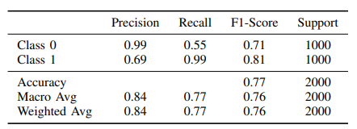
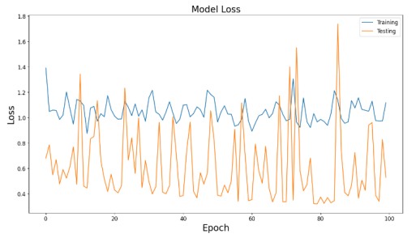
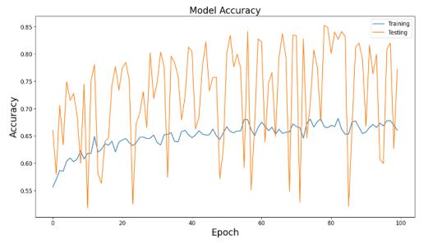
RESNET 50 Results

Slide 7
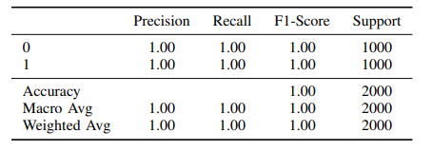
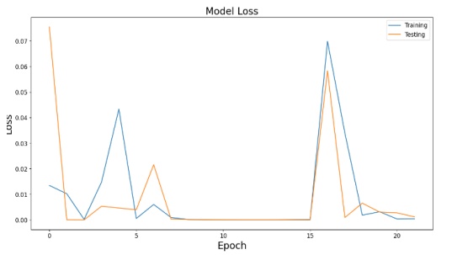
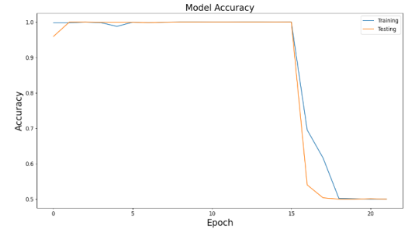
Mobile Net Results

Slide 8
Conclusion
Impactful Solution: Our project's drowsy driver detection system offers a tangible contribution to road safety.
Effective Transfer Learning: Leveraging pre-trained models and custom enhancements demonstrated improved accuracy and efficiency.
Real-World Applicability: The optimized models show potential for practical deployment in real-time driving scenarios.
Continual Advancements: Our work underscores the ongoing potential for refining and expanding AI-driven safety solutions.

Slide 9
Questions?

